Slide 1
How hackers helped during the Citrix Crisis last January
Or, “be careful what you wish for…”

Slide 2
> whoami
Frank Breedijk
Day job:
CISO at Schuberg Philis
Night job:
Coordinator and instigator SecurityMeldpunt.nl
Remainder of live:
Dad, husband, horses, 1751 farmhouse
Former author of Seccubus
Hacker for suits, suit for hackers
f.breedijk@divd.nl

Slide 3
May contain <rant> blocks….
You have been warned….

Slide 4
This is a Citrix talk, but…

Slide 5
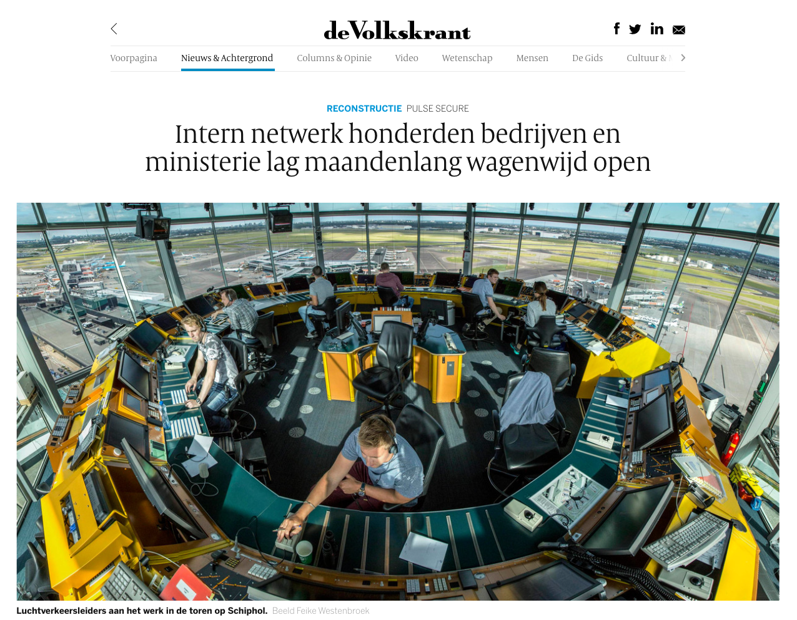
Source: https://www.volkskrant.nl/nieuws-achtergrond/intern-netwerk-honderden-bedrijven-en-ministerie-lag-maandenlang-wagenwijd-open~b9c96034/

Slide 6
Source: https://fd.nl/ondernemen/1318504/justitie-wil-ingrijpen-bij-bedrijven-die-digitale-beveiliging-niet-op-orde-hebben

Slide 7
Oliebollen!
Image CC SA by Franklin Heijnen https://www.flickr.com/photos/37818606@N00/16154788972/

Slide 8
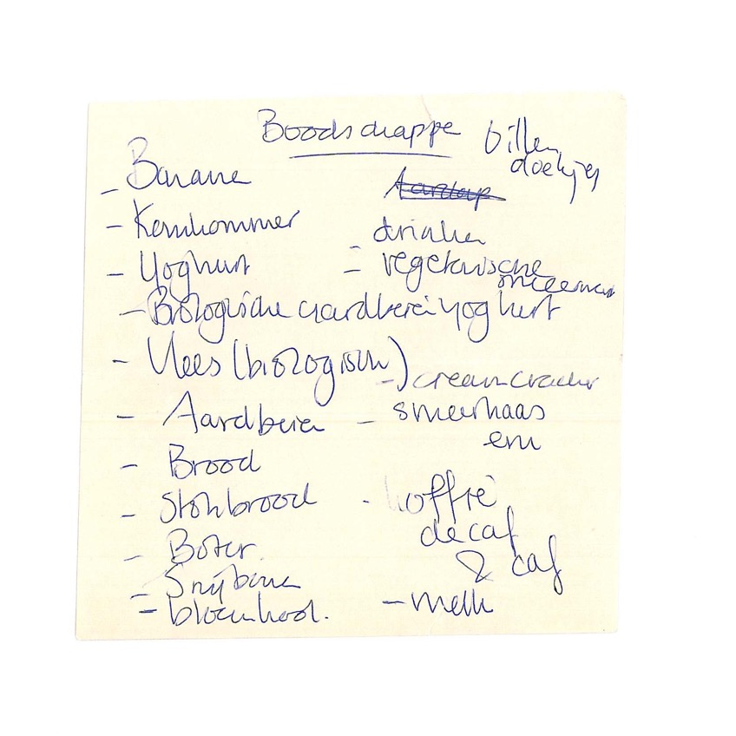
Making a list, checking it twice….
So:
We did have a list of vulnerable devices (in The Netherlands)
The minister of Justice and Security called companies that didn’t patch ‘oliebol’
But, who, how, why…?
HELP!
‘ boodschappenbriefje’ a CC NC SA image by marie-II https://www.flickr.com/photos/71477195@N00/9727882185/

Slide 9
Objections, you honor…
Turns out the NCSC cannot/is not allowed to share with everybody:
IP addresses are PII
They need a legal basis
Cannot process/share/generate certain information
Is not mandated
“Convert GDPR” https://www.Convert.com/GDPR/

Slide 10
Legal mumbojumbo ahead…

Slide 11
WBNI…

Slide 12
</LEGAL>
Please wake you neighbour…

Slide 13
Supporting your constituency…
Pick the most correct answer.
Creating a system that covers the entire population (nld) this way…:
Will take very long.
Will not result in complete coverage.
Will fail due to its massive overhead.
All of the above.
Image by Maria Pia Barraco via Scopio

Slide 14
So my wish…

Slide 15
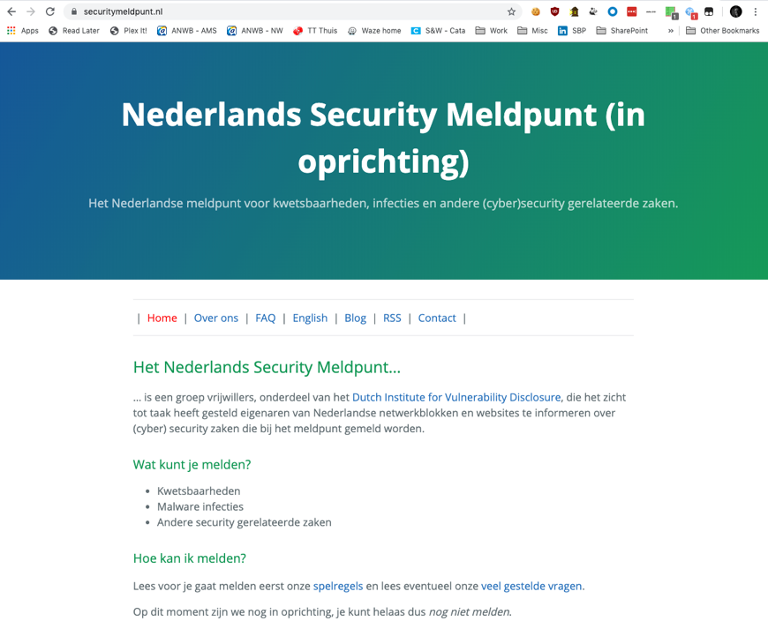
A potential solution?
A volonteer’s effort at ”victim notification”
Private, so we can use legitimate interest (“gerechtvaardigd belang”)
By de community, for everybody.
www.securitymeldpunt.nl

Slide 18
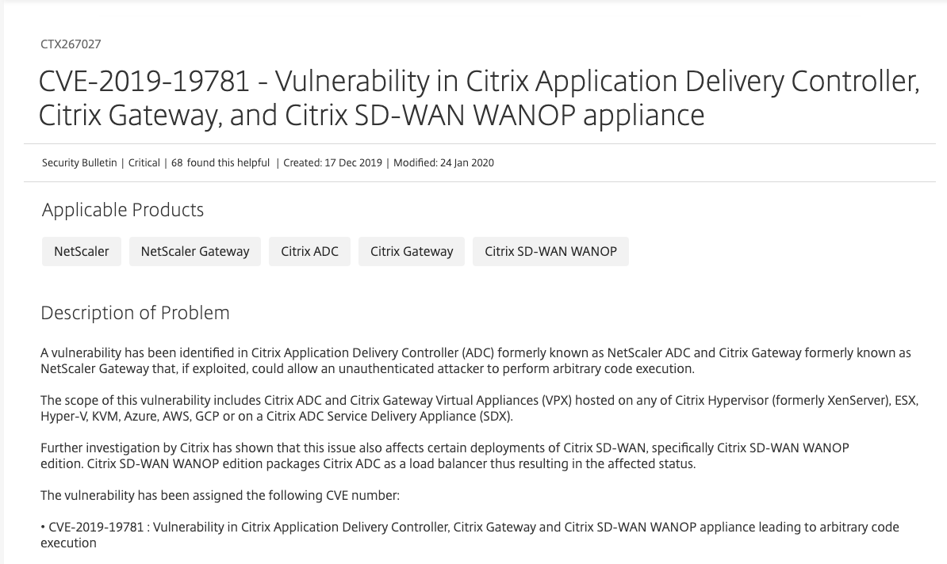
December 17th 2019
Source: https://support.citrix.com/article/CTX267027

Slide 19
December 23th 2019

Slide 20
Citrix Unified Infra
Citrix (MDM)
SSL passthrough, whitelisting hard
ICA protocol over tcp/443, renders WAFs unusable
Citrix

Slide 21
But, here’s a mitigation…
Source: https://support.citrix.com/article/CTX267679

Slide 23
Well, actually….. (Thanks Victor ;)

Slide 25
7 januari 2020
Source: https://isc.sans.edu/forums/diary/A+Quick+Update+on+Scanning+for+CVE201919781+Citrix+ADC+Gateway+Vulnerability/25686/

Slide 26
January 9th 2020

Slide 27
11th January 2020

Slide 28
11 Januari 2020
Source: https://twitter.com/ProjectZeroIN/status/1215772214122795010?s=20

Slide 29
Enough talk, time to PWN

Slide 30
In case the demo gods are not with me…

Slide 31
So what just happened…
Requests to /vpns/ are handled by Netscaler::Portal::Handler (Yes, that’s Perl)
Netscaler::Portal::Handler::UserPrefs creates a file name, based on the NTTP_NSC_USER name header
No checks are applied.
Wait, a file name, based on user supplied input field? Could this turn into Path Traversal number 2?

Slide 32
Just path traversal?
newbm.pl uses the filename generated by UserPrefs to
Take several parameters from the user
Create XML content
Write the file to the UserPref generated file
Yes, we have Path Traversal number 2 AND we can write to an XML file without restrictions…
That’s a problem in itself, but hard to exploit, unless…

Slide 33
Template engine ftw…
Some XML files are run through the Perl Template Toolkit and it has a know code excution bug.
So, if we construct the right kind of template and then call it…
PROFIT!
See: https://www.mdsec.co.uk/2020/01/deep-dive-to-citrix-adc-remote-code-execution-cve-2019-19781/ for the full analysis

Slide 34
How did hackers help?
‘Little Hackers’ a CC SA image by Salim Virji
https://flic.kr/p/amAu7

Slide 35
Thank you Matthijs! (Yes, I missed two instances, too) (And, they were fixed within 15 minutes of you telling me)
‘Thanks’ a CC SA image by the_solitary_geoscientist
https://flic.kr/p/qUFpUc`

Slide 36
But… Wait a minute !?!?!
If I missed this one, other must have too…
This is being scanned for like crazy
Can I be mad at others for doing nothing, and do nothing
Is it O.K. for me to do nothing?
Image copyright Scop.io

Slide 39
13th of January 2020

Slide 40
17 Jan, 2020

Slide 42
Day job vs. night job
Customers to call
Advisories to write
Systems to take off-line
…., and the PoC for chain of fools was released
Hmmm, maybe we should update SecurityMeldpunt.nl too?
‘Hats on Display at Trash to Treasure sale’ a CC NC ND image by Penn State https://flic.kr/p/eySTjN

Slide 43
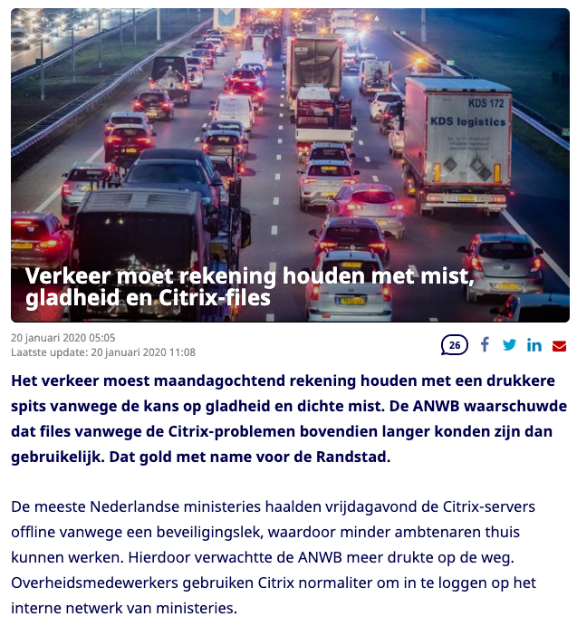
Jan 20th 2020
Traffic jams?
Maandagochtend op de weg (20-1-20)
Maandagochtend is er landinwaarts kans op hardnekkige mist waardoor spitsstroken wellicht niet kunnen worden gebruikt. Ook kan het glad zijn op bruggen en viaducten. Er wordt minder thuisgewerkt vanwege de Citrix-problemen. Er is daardoor meer verkeersaanbod. De files zullen dus, vooral in de Randstad, langer zijn dan gebruikelijk. Bij Dordrecht zorgt de afsluiting van de N3 voor extra drukte op omliggende wegen.
Bron: Cees Quax, ANWB Verkeersinformatie

Slide 44
Net result…

Slide 45
January 20th: So, this are settling right?
Let’s look at that data again…
More then 60% of the vulnerable systems on the ”The Netherlands” list used wildcard certificates
Uh-oh…..
Image copyright Scop.io

Slide 47
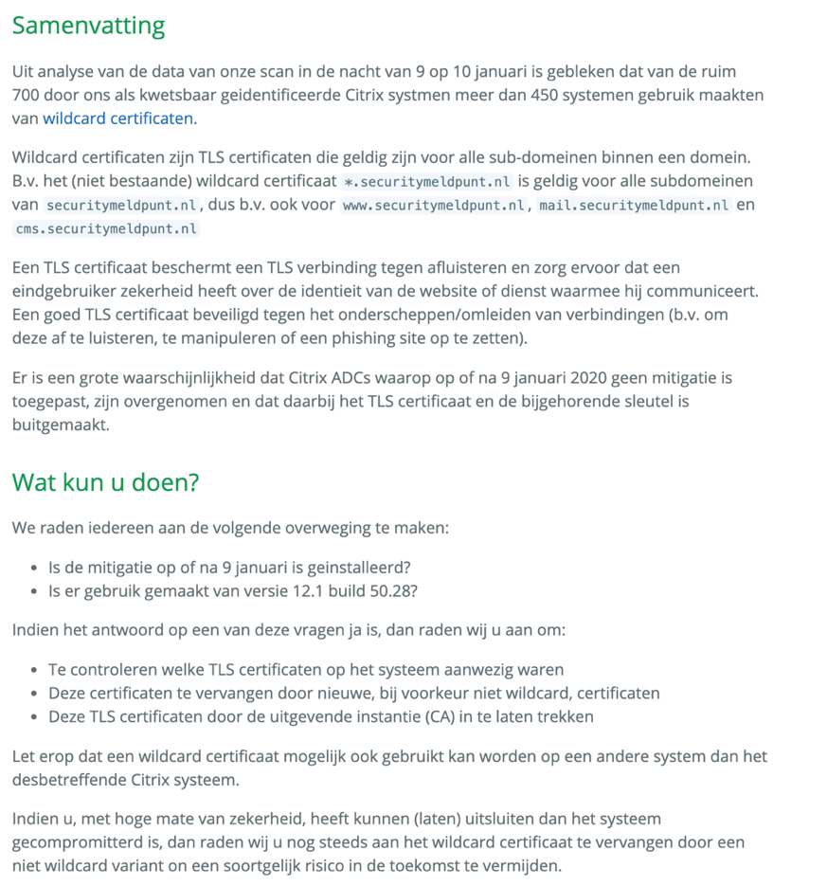

Slide 48
Let mail abuse, security and info@
362 domains
4% no MX records
Security@ bounces – 86%
Abuse@ bounces – 83%
Info@ bounces – 27%
All three bounce – 24%
RFC2142

Slide 49
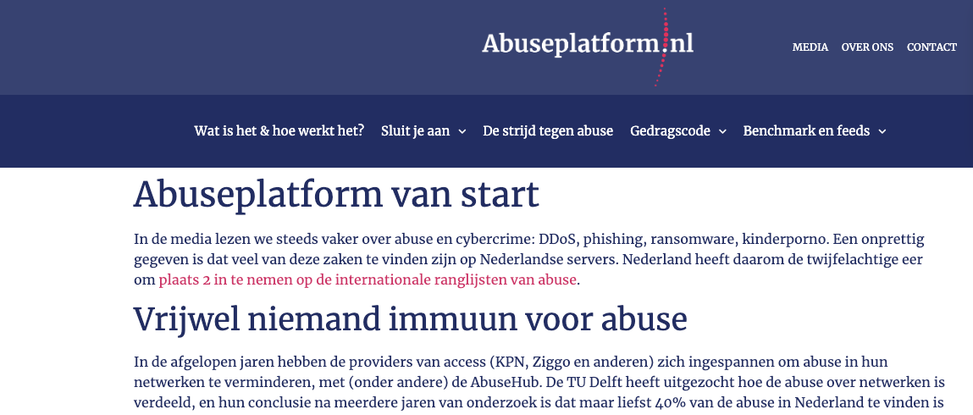
There’s go to be a better way…

Slide 50
Jan 20-30 – Patches, patches, patches, patches, patches… mushroom, mushroom!
CyberSprint has analyzed the patches…
Quality control on the patches seems poor
It is not just spelling, there is a logic flaw in them as well…
Future CVE ??!?!

Slide 51
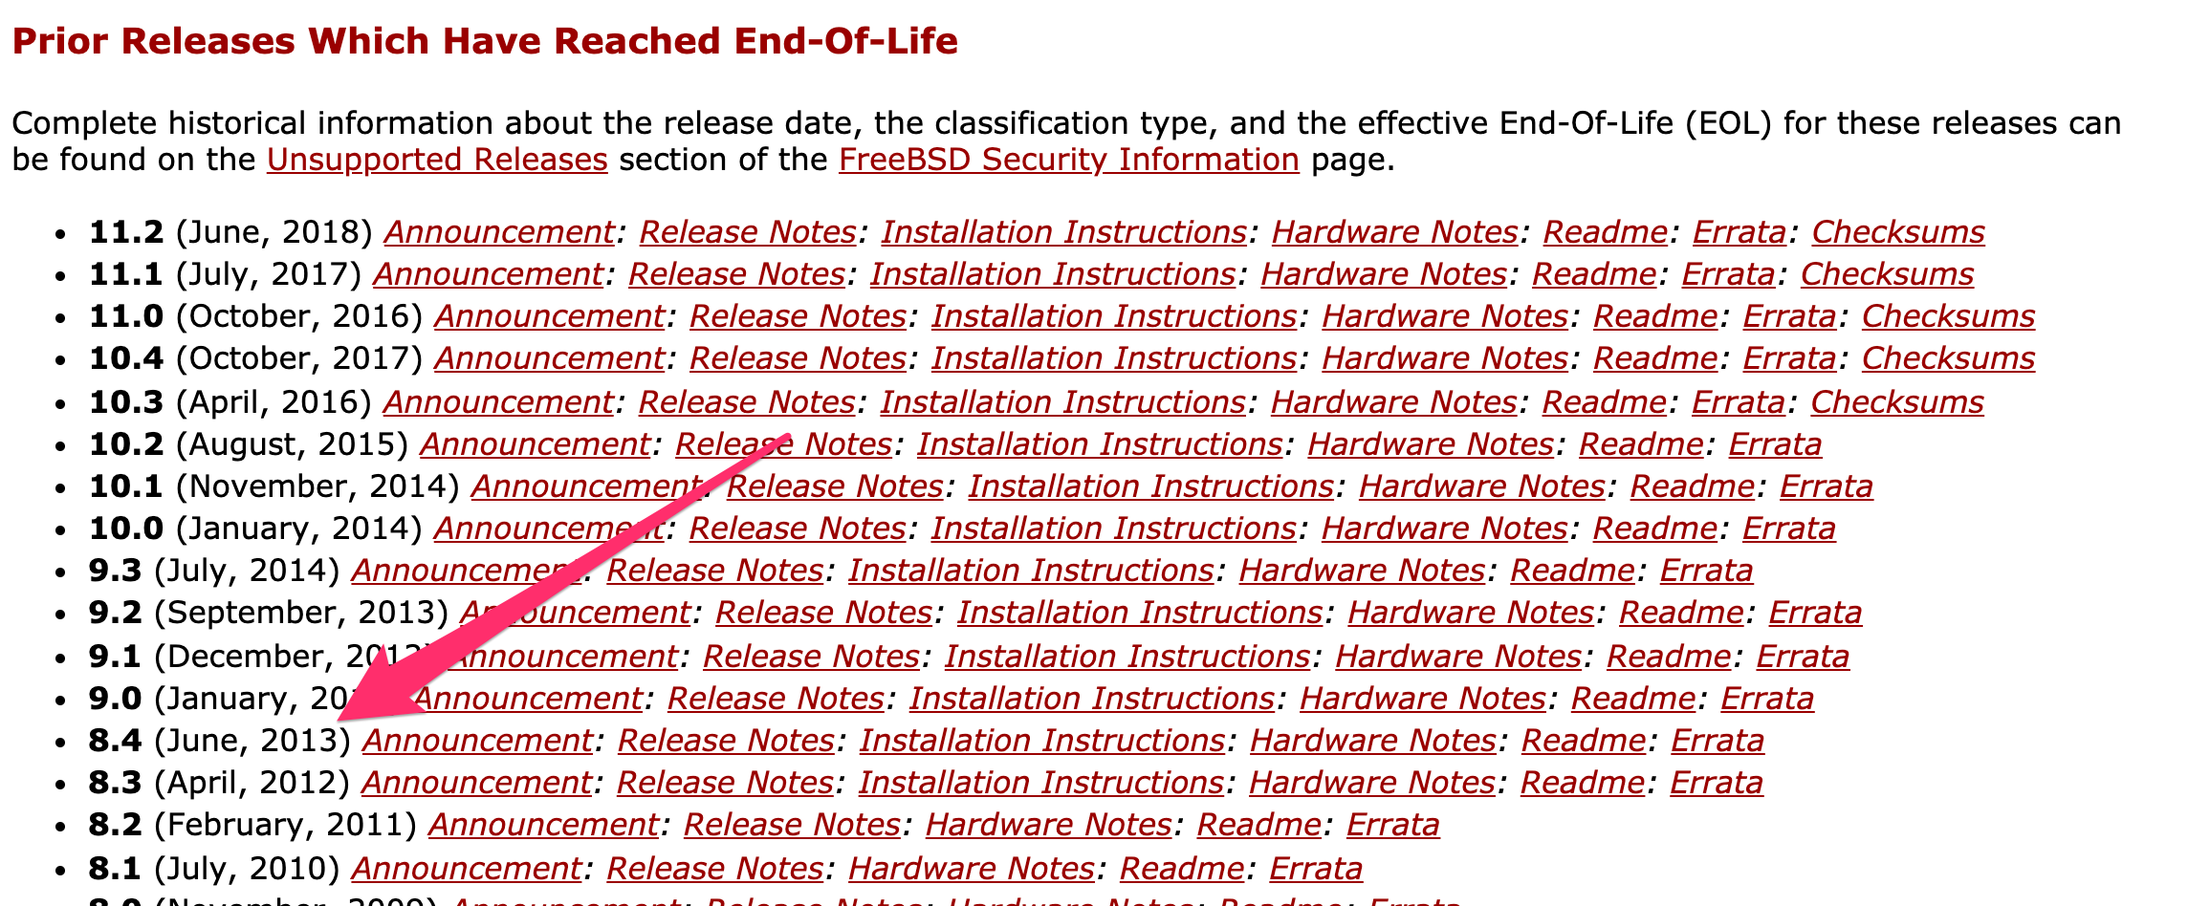
Will this gift keep on giving?

Slide 52
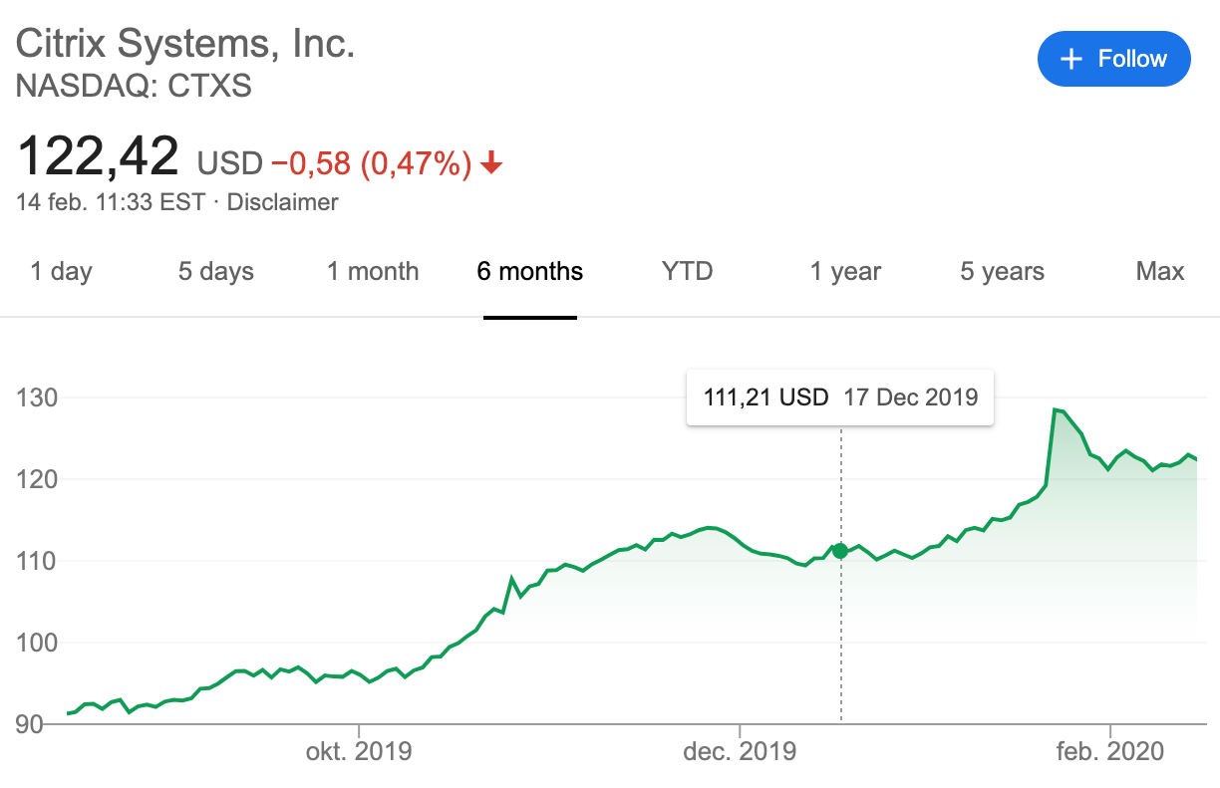
February 14th 2020
There’s not bad attention, just attention..

Slide 53
So what’s next?
DIVD-2020-00001 – Citrix
DIVD-2020-00002 – Wildcard certificates on Citrix
DIVD-2020-00003 – BlueGate
DIVD-2020-00004 – Mirai victim information
DIVD-2020-00005 – Unknown (yet?)
DIVD-2020-nnnnn – n = ?

